Slide 1

Social Media Analysis
PRESENTED BY S.SHIVA KUMAR YADAV
DATE: 19/02/2025

Slide 2

Introduction to Instagram
Instagram is a popular social media platform designed for photo and video sharing. It was launched in 2010 by Kevin Systrom and Mike Krieger and later acquired by Facebook (now Meta) in 2012. With over 2 billion active users, Instagram has become a leading platform for personal expression, business promotion, and influencer marketing.

Slide 3
Key Features of Instagram:
📷 Photo & Video Sharing – Users can post pictures and videos to engage with followers.
🎭 Stories – Short-lived posts that disappear after 24 hours, perfect for updates.
🎬 Reels – Short-form, engaging videos similar to TikTok, with music and effects.
🔍 Explore Page – Discover trending content and new accounts based on interests.
💬 Direct Messaging (DMs) – Private communication with individuals or groups.
🏷️ Hashtags & Geotags – Helps increase post visibility and engagement.
📈 Business & Shopping Features – Brands can promote products and sell directly via

Slide 4

OBJECTIVE
The primary objective is to leverage this rich user data to develop targeted marketing strategies that drive increased user engagement, improve retention, and boost new user acquisition.
By analyzing patterns in user behavior—such as interactions with posts, hashtag usage, Posts likes and comments—marketers can gain deep insights into what resonates with their audience.

Slide 5
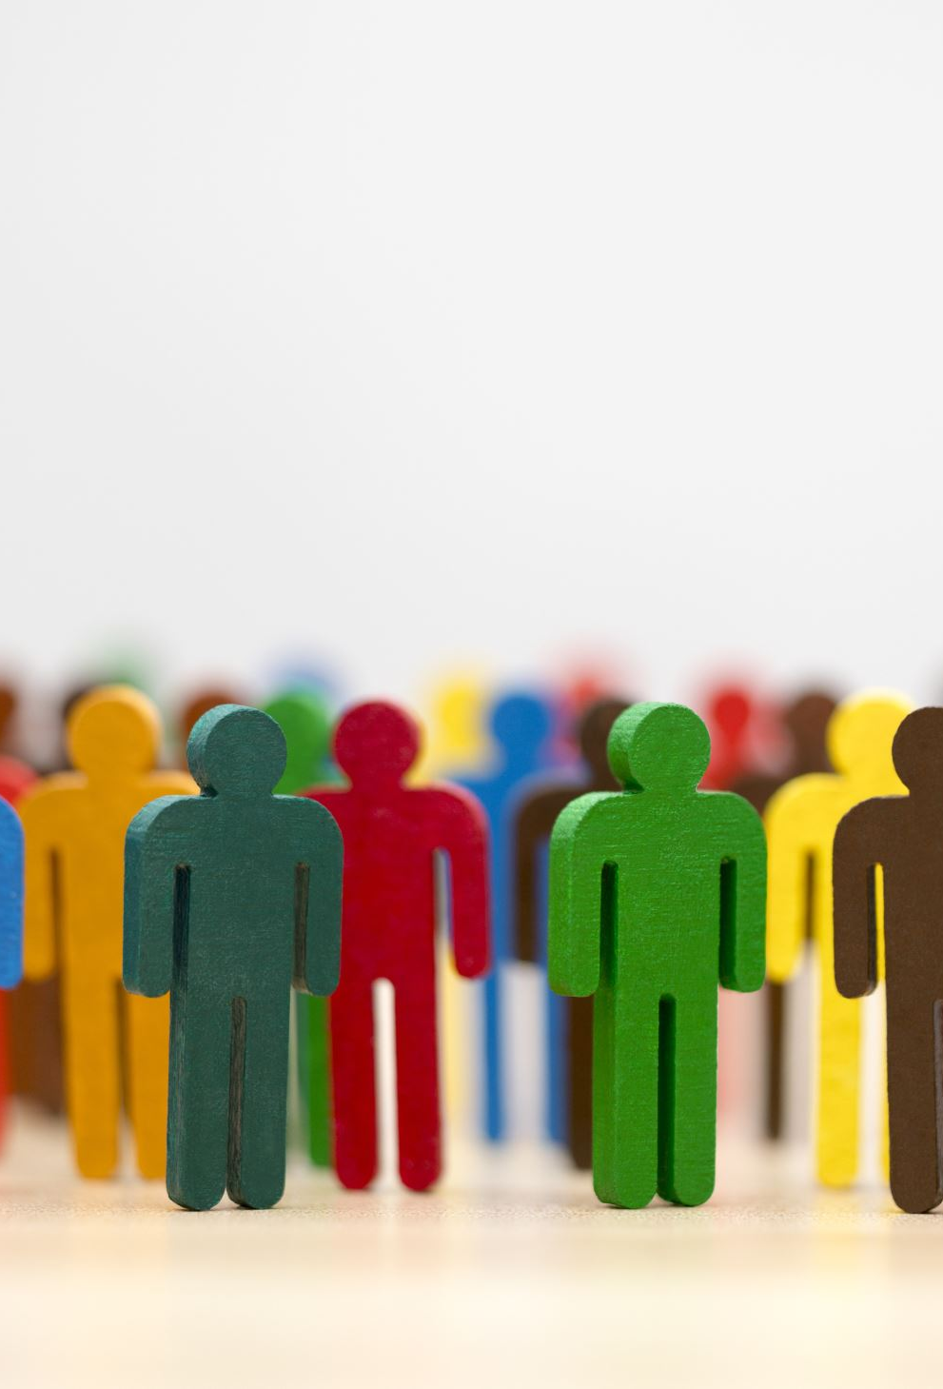
Problem Statement
Marketing teams wants to leverage Instagram's user data to develop targeted marketing strategies that will increase user engagement, retention, and acquisition. Provide insights and recommendations

Slide 6

Data Overview
Data Source:
Ig_clone Dataset: Includes tables like Users, follows, photos, likes, comments, photo tags and tags.
Key Metrics Analyzed:
Users: Total No. of Users.
Posts: Total Posts by the Users.
Likes: No. of Likes for the posts.
Comments: No. of comments for the posts.
Photo_tags: Tags for each post.
Tools Used:
SQL Workbench: data querying, extraction.
Excel: visualization, in-depth analysis.

Slide 7
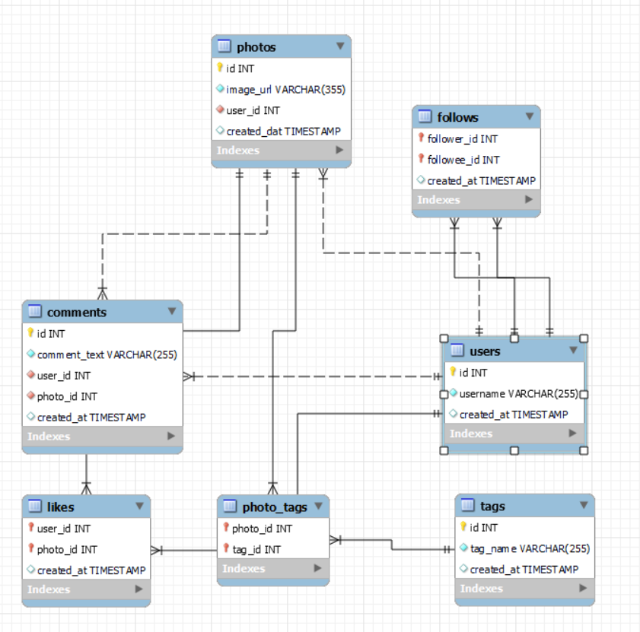
DATABASE SCHEMA

Slide 8
Performance Insights
This is the list of the top 10 performers who are actively using Instagram.
I calculated based on the total posts, likes, comments and tags used in the posts.
We can choose them as influencers and we can promote the products.

Slide 9
Username | Activity
Hulda.Macejkovic | 0
Leslie67 | 0
Kasandra_Homenick | 0
Mckenna17 | 0
Mike.Auer39 | 0
Franco_Keebler64 | 0
Jessyca_West | 0
Linnea59 | 0
Morgan.Kassulke | 0
Janelle.Nikolaus81 | 0
Nia_Haag | 0
Bartholome.Bernhard | 0
Esmeralda.Mraz57 | 0
Rocio33 | 0
Esther.Zulauf61 | 0
Bethany20 | 0
David.Osinski47 | 0
Tierra.Trantow | 0
Ollie_Ledner37 | 0
Aniya_Hackett | 0
Pearl7 | 0
Maxwell.Halvorson | 0
Duane60 | 0
Darby_Herzog | 0
Jaclyn81 | 0
Julien_Schmidt | 0
INACTIVE USERS
This is the list of the users who are inactive on Instagram.
We can make them active by using a reward system.
Reward users for returning and engaging. By assigning Come back and earn a “Welcome Back Badge”.
Giving points to users whenever they interact with posts. Later, those points can be redeemed in App-Purchases.
Rewarding the users on referral or inviting new users.
Create a campaign for the user like “7-day posting Challenge” and get rewards after completing it.

Slide 10
Distribution of Tags Likes and Comments
The Highest number of Likes for the TAG is “SMILE”.
We can create the content or pictures around the highest tag interactions to make it engaging to the users.
With the help of tags the posts can reach to similar interest users and be shared widely.

Slide 11
Users who never liked any posts
id | username
1 | Kenton_Kirlin
7 | Kasandra_Homenick
23 | Eveline95
25 | Tierra.Trantow
29 | Jaime53
34 | Pearl7
45 | David.Osinski47
49 | Morgan.Kassulke
51 | Mariano_Koch3
53 | Linnea59
58 | Aurelie71
59 | Cesar93
64 | Florence99
68 | Franco_Keebler64
74 | Hulda.Macejkovic
77 | Donald.Fritsch
80 | Darby_Herzog
81 | Esther.Zulauf61
83 | Bartholome.Bernhard
86 | Delfina_VonRueden68
88 | Clint27
89 | Jessyca_West
90 | Esmeralda.Mraz57
This is the list of the users who never liked any posts on Instagram.
We can make them active by using a reward system.
Giving points to users whenever they interact with posts. Later, those points can be redeemed in App-Purchases.
Rewarding the users on referral or inviting new users.
Create a campaign for the user like the “7-day Interaction Challenge” and get rewards after completing it.

Slide 12
Average No. Tags
The average number of tags per post is 2.64.
This needs to be increased, because of the tags the photos will reach wide users who are interested in the tags.
This will help more new or inactive users to engage or interact.

Slide 13
Distribution of Users Activity
We can observe that moderately active users are more in numbers compared to others.
The Inactive users are 13%.

Slide 14
Personalising the Ads
We can Personalize the User Ads based upon their Interests.
We can take the data of tags and count of it, based on this we can personalize the ads for that particular user.
We can also take the posts interaction data of likes of the users then we can personalize the Ads based on that.
We can also see the what user is watching more the content type and content, based on that we can personalize the Ads to users.
username | tagname | count
Clint27 | beach | 6
Eveline95 | smile | 5
Clint27 | dreamy | 4
Andre_Purdy85 | fun | 3
Andre_Purdy85 | smile | 3
Tabitha_Schamberger11 | smile | 3
Gus93 | stunning | 3
Eveline95 | hair | 3
Eveline95 | lol | 3
Cesar93 | fun | 3
Adelle96 | smile | 3
Clint27 | sunrise | 3
Clint27 | sunset | 3

Slide 15
Recommendations
Prioritize content formats and hashtags that drive the most likes, comments, and shares.
Segment users by engagement levels and interests to tailor ads and re-engagement strategies.
Identify users with strong follower counts and engagement rates to amplify brand reach.
Run challenges and giveaways to motivate users to create and share more content.

Slide 16
Conclusion
Choose the Higley active users as Influencers for promoting the product.
Choose Trending Tags for the posts to reach a wide range of users.
To Activate the Inactive users, Create a campaign for the user like the “7-day Interaction Challenge” and get rewards after completing it.
By assigning Come back and earn a “Welcome Back Badge”.

Slide 17
Thank you

